Slide 1
Project Scheduling and Tracking

Slide 2
What does the customer want to know?
Do you understand my needs?
Can you design a system to help me?
How long will it take?
How much will it cost?

Slide 3
Scheduling Principles - 1
Compartmentalization
  the product and process must be decomposed into a manageable number of activities and tasks
Interdependency
  tasks that can be completed in parallel must be separated from those that must completed serially
Time allocation
  every task has start and completion dates that take the task interdependencies into account

Slide 4
Scheduling Principles - 2
Effort validation
  project manager must ensure that on any given day there are enough staff members assigned to completed the tasks within the time estimated in the project plan
Defined Responsibilities
  every scheduled task needs to be assigned to a specific team member

Slide 5
Scheduling Principles - 3
Defined outcomes
  every task in the schedule needs to have a defined outcome (usually a work product or deliverable)
Defined milestones
  a milestone is accomplished when one or more work products from an engineering task have passed quality review

Slide 6
Step 1
List the Deliverables
Documents.
Demonstration of function.
Demonstration of subsystem.
Demonstration of accuracy.
Demonstration of reliability, security, or speed.

Slide 7
Step 2
Define the Milestones
Completion of an activity or deliverable (must be measurable).
Activities must have definite a start and stop.
A milestone is point in time not a time period like an activity.

Slide 8
Step 3
Work Breakdown Structure
Create the work breakdown structure
Separate the project into phases composed of steps
Subdivide steps into activities as needed

Slide 9
Project Effort Distribution
Generally accepted guidelines are:
  02-03 % planning
  10-25 % requirements analysis
  20-25 % design
  15-20 % coding
  30-40 % testing and debugging

Slide 10
Defining a Task Set
Consider project type.
Degree of rigor.
Review rigor adaptation criteria.
Determine task selector value.
Consider concept development tasks.

Slide 11
Software Project Types - 1
Concept development
  initiated to explore new business concept or new application of technology
New application development
  new product requested by customer
Application enhancement
  major modifications to function, performance, or interfaces (observable to user)

Slide 12
Software Project Types - 2
Application maintenance
  correcting, adapting, or extending existing software (not immediately obvious to user)
Reengineering
  rebuilding all (or part) of a legacy system

Slide 13
Software Process Degree of Rigor - 1
Casual
  all framework activities applied, only minimum task set required (umbrella activities minimized and documentation reduced)
Structured
  all framework and umbrella activities applied (SQA, SCM, documentation, and measurement tasks are streamlined)

Slide 14
Software Process Degree of Rigor - 2
Strict
  full process and umbrella activities applied (high quality products and robust documentation produced)
Quick reaction
  emergency situation, process framework used, but only tasks essential to good quality are applied (back filling used to develop documentation and conduct additional reviews after product is delivered)

Slide 15
Rigor Adaptation Criteria
Size of project
Number of potential users
Mission criticality
Application longevity
Requirement stability
Ease of customer/developer communication
Maturity of applicable technology
Performance constraints
Embedded/non-embedded characteristics
Project staffing
Reengineering factors

Slide 16
Task Selector Value
Computed by scoring rigor adaptation criteria and adjusting the scores using differential weighting based on project characteristics.
Once computed the task selector value can be used to select the appropriate task set (casual, structured, strict) for the project.
It is OK to choose a less formal degree of rigor when the task selector value falls in the overlap area between two levels of rigor, unless project risk is high.

Slide 17
Concept Development Tasks -1
Concept scoping
  determine overall project scope
Preliminary concept planning
  establishes development team's ability to undertake the proposed work
Technology risk assessment
  evaluates the risk associated with the technology implied by the software scope

Slide 18
Concept Development Tasks - 2
Proof of concept
  demonstrates the feasibility of the technology in the software context
Concept implementation
  concept represented in a form that can be used to sell it to the customer
Customer reaction to concept
  solicits feedback on new technology from customer

Slide 19
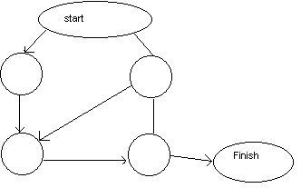
Activity Graph
Each activity has:
Precursor
Duration
Due date
End point (milestone or deliverable)

Slide 20
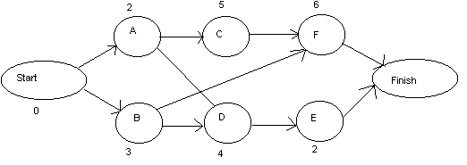
CPM
Critical Path Method

Slide 21
Activity
Precursor
Duration
EST
EFT
LST
LFT
Slack
Start
-
0
0
0
0
0
0
A
Start
2
0
2
0
2
0
B
Start
3
0
3
4
7
4
C
A
5
2
7
2
7
0
D
A,B
4
3
7
7
11
4
E
D
2
7
9
11
13
4
F
B,C
6
7
13
7
13
0
FINISH
E,F
0
13
13
13
13
0
EST = earliest start time, EFT = earliest finish time.
LST = latest start time, LFT = latest finish time.
Slack = (LST - EST) or (LFT - EFT).

Slide 22
CPM Equations
EST(START) always = 0, EFT(START) always = 0.
LST(START) always = 0, LFT(START) always = 0.
EFT(I) = EST(I) + DUR(I).
EST(I) = max(EFT of all predecessors).
LST(I) = LFT(I) - DUR(I).
LFT(I) = min(LST of all sucessors).
LFT(FINISH) = LST(FINISH) = EST(FINISH) = EFT(FINISH).
Critical path is all nodes with Slack = 0.

Slide 23
Program Evaluation and Review Technique
JAN
FEB
TASK
EARLIEST START
LATEST START
1
8
15
22
29
5
12
17
24
1
1/1
2/5
*
*
*
*
*
*
2
1/1
1/8
*
*
3
1/9
1/22
*
*
*
*
4
1/9
1/22
*
*
*
*
5
1/23
2/1
*
*
*
6
1/23
2/1
-
-
F
7
1/23
2/17
-
-
F
F
F
8
2/2
2/17
*
*
*
*
* = critical activity, - = non-critical, F = float or slack

Slide 24
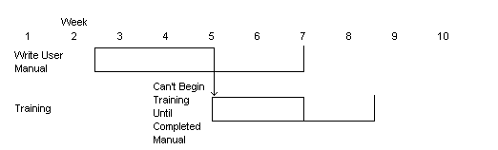
Gantt Chart

Slide 25
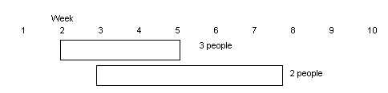
Overlay Resources on Gantt Chart

Slide 26
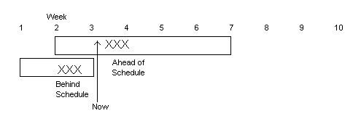
Milestone Chart

Slide 27
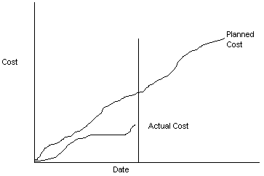
Line Graph

Slide 28
People and Effort
Adding people to a project after it is behind schedule often causes the schedule to slip further
The relationship between the number of people on a project and overall productivity is not linear (e.g. 3 people do not produce 3 times the work of 1 person, if the people have to work in cooperation with one another)
The main reasons for using more than 1 person on a project are to get the job done more rapidly and to improve software quality.

Slide 29
Earned Value Analysis
Earned value is a quantitative measure of percent of project completed so far.
The total hours to complete the entire project are estimated and each task is given an earned value based on its estimated percentage contribution to the total.

Slide 30
Error Tracking
Allows comparison of current work to past projects and provides a quantitative indication of the quality of the work being conducted.
The more quantitative the approach to project tracking and control, the more likely problems can be anticipated and dealt with in a proactive manner.

